Slide 1
PLAY STORE REVIEW ANALYSIS
PROJECT
Presented By:
SRIRAM R – JEPPIAAR ENGINEERING COLLEGE
Department-B-TECH-INFORMATION TECHNOLOGY

Slide 2
OUTLINE
Problem Statement
Proposed System/Solution
System Development Approach
Result
Conclusion
Future Scope
References

Slide 3
Problem Statement
The Play Store apps data has enormous potential to drive app-making businesses to success. Actionable insights can be drawn for developers to work on and capture the Android market. Each app (row) has values for category, rating, size, and more. Another dataset contains customer reviews of the android apps. Explore and analyse the data to discover key factors responsible for app engagement and success.

Slide 4
Proposed Solution
1.Data Collection:
Load the Datasets: Load the Play Store apps data and the customer reviews dataset into a data analysis environment.
2.Data Understanding and Cleaning:
Inspect the Data: Examine the structure of the datasets, including the columns and types of data.
Handle Missing Values: Identify and handle missing or incomplete data entries.
Remove Duplicates: Ensure there are no duplicate entries in the datasets.
Normalize Data: Convert data to a consistent format where necessary
3.Data Visualization
Visualize Distributions: Create visualizations to understand data distributions (e.g., histograms, box plots).
Correlation Analysis: Visualize the correlation between different features

Slide 5
System Approach
The "System Approach" section outlines the overall strategy and methodology for developing and implementing the Playstore review analysis Here's a suggested structure for this section:
System requirements : windows 11 operating system , 8GB RAM, I3 Processor
Library required to build the model : Google colab / Jupyternotebook
Code access: Github

Slide 6
Result
By analyzing Play Store apps data and customer reviews, we identified several key factors influencing app engagement and success. Developers can leverage these insights to improve their apps and better capture the Android market. Specifically, focusing on user sentiment, optimizing app size, and strategically pricing the app can significantly enhance user engagement and satisfaction. you can uncover key factors that contribute to app engagement and success. This information can guide developers to make informed decisions to improve their apps and capture the Android market.

Slide 7
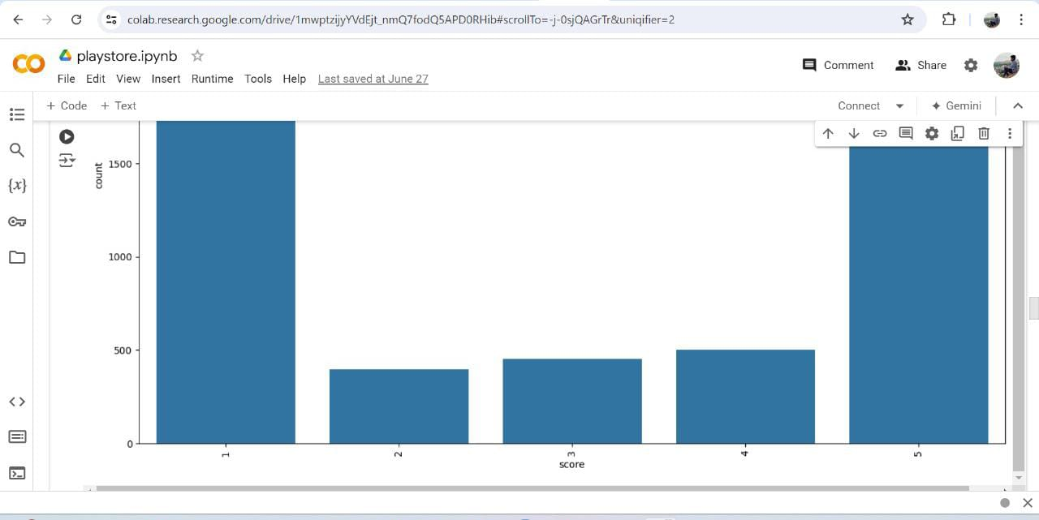
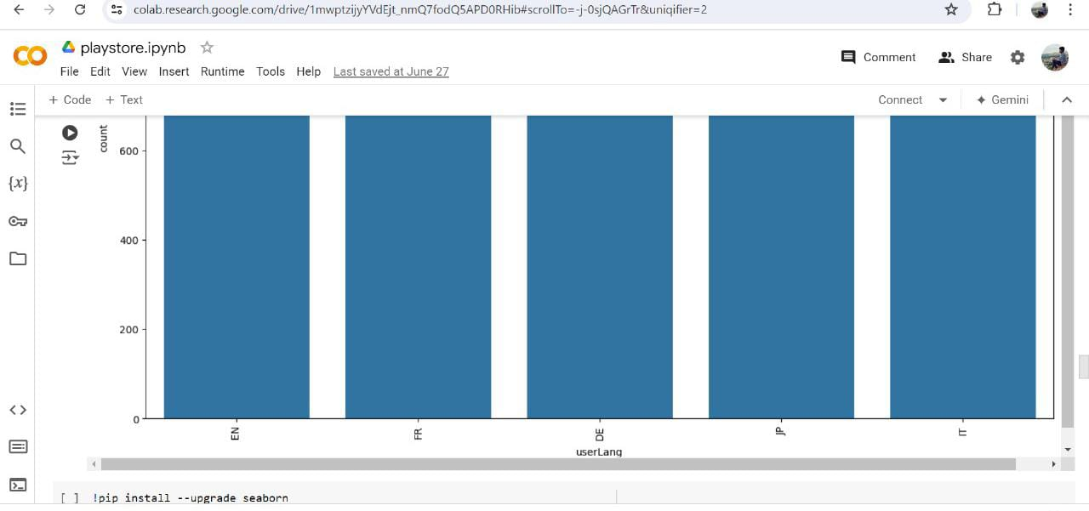
Result

Slide 8
Conclusion
Through a comprehensive analysis of Play Store apps data and customer reviews, we have identified several critical factors that influence app engagement and success. Key determinants include app category, size, number of installs, price, and user sentiment. Additionally, elements like content rating, update frequency, design, localization, and effective use of metadata significantly impact app performance. Developers can leverage these insights to enhance their apps, ensuring they meet user expectations and capture a larger share of the Android market. Regular updates, a focus on high-quality user experiences, and strategic pricing are essential strategies. Moreover, optimizing app metadata and conducting sentiment analysis can provide ongoing feedback for continuous improvement. By implementing these findings, developers can better align their products with market demands, leading to higher engagement and success in the competitive Play Store ecosystem.

Slide 9
1.Advanced Predictive Modeling: Utilize advanced machine learning techniques such as deep learning, ensemble methods, and neural networks to build more accurate predictive models. These models can forecast app success, user engagement, and retention more effectively by capturing complex patterns and relationships within the data.
2.Real-time Analytics: Develop real-time analytics platforms that continuously monitor app performance, user reviews, and market trends. This would enable developers to quickly identify and respond to issues, track the impact of updates, and stay ahead of emerging trends.
3.Incorporating External Data Sources: Integrate external data sources such as social media mentions, competitor analysis, and market research reports. This holistic approach can provide a more comprehensive understanding of the factors influencing app success and help identify new opportunities for growth.
Future scope

Slide 10
References
Kaggle data analysis
Google colab /juyptur notebook

Slide 11
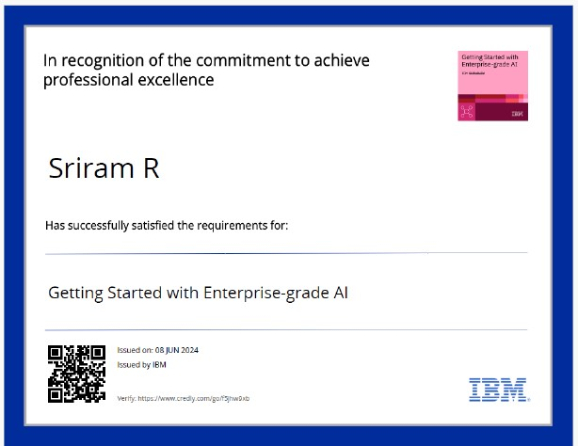
course certificate 1

Slide 12
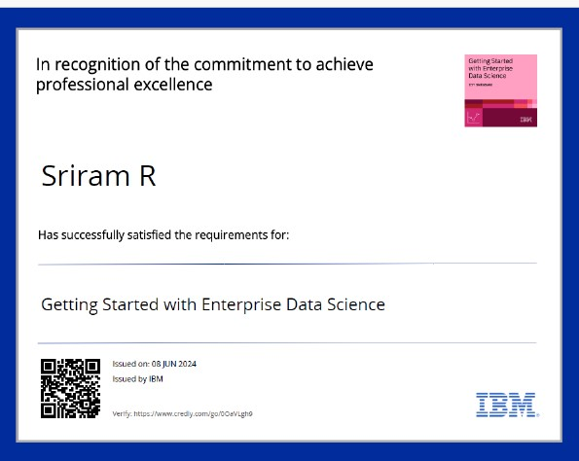
course certificate 2

Slide 13
THANK YOU

